Slide 1


Slide 2
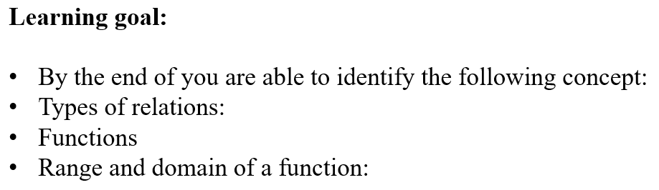

Slide 3

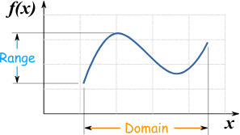
Functions and set notations:

Slide 4
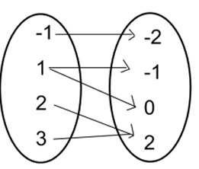
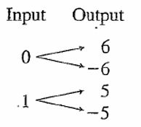
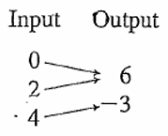
Warm Up:
DOMAIN: The domain of a relation is the set of all inputs. RANGE: The range of a relation is the set of all outputs.

Slide 5
Worked Example 2:
For each of the following relation, state the domain and range, and whether the relation is a function or not.

Slide 6
Interval notation
Interval notation is a way to describe continuous sets of real numbers by the numbers that bound them.

Slide 8
Set notation

Slide 10
Worked Example 2:
Sketch the graph representing each of the following relations and state whether each is discrete or continuous.
Note:

Slide 11
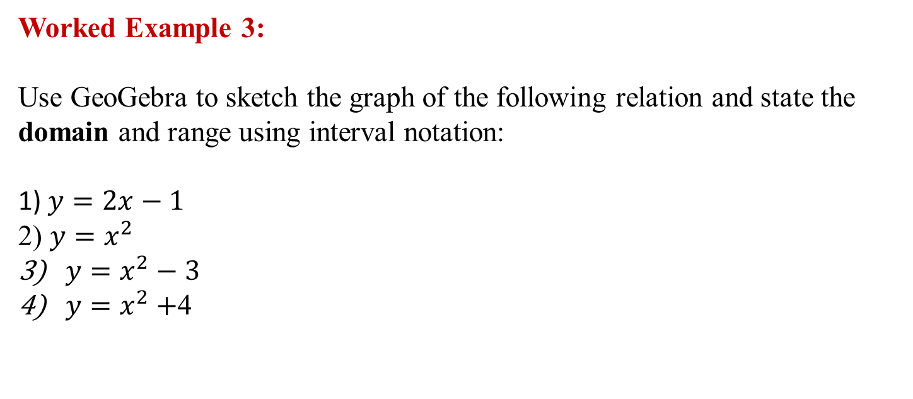
Worked Example 3:
Use GeoGebra to sketch the graph of the following relation and state the domain and range using interval notation:
1) $y=2x−1$
2) $y=x^{2}$
$y=x^{2}−3$
$y=x^{2}+$4

Slide 12
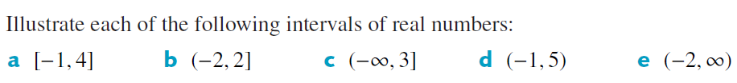
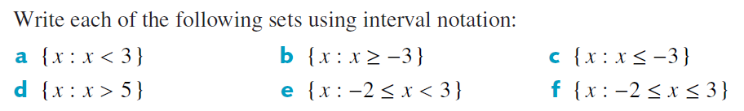
Your turn:

